Slide 1
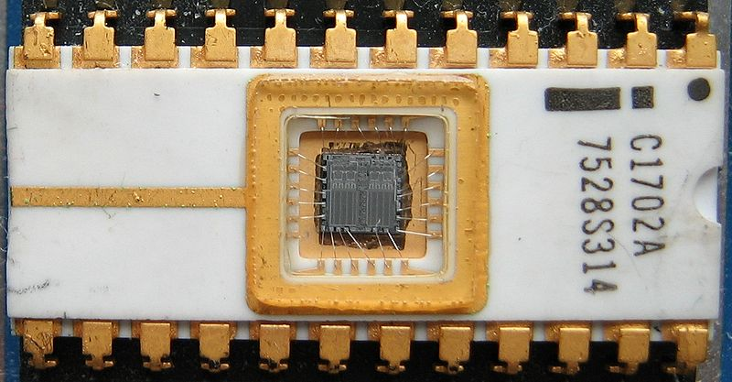
CHAPTER 4
COMPUTER MEMORY SYSTEM

Slide 2
Topics
4.1) Computer Memory System
4.2) Internal Memory
4.3) External Memory
4.4) Cache Memory System

Slide 3

4.1) Computer Memory System
Generally, computer memory system can be divided into 2 categories:
Internal memory
External/Secondary Memory

Slide 4
Memory Hierarchy
Decrease cost per bit (shorter access time→greater cost per bit)
Increase capacity (Internal memory is much smaller than external memory)
Increase access time (It is always faster to access data from internal memory and greater capacity → longer access time)
Decrease frequency of access by the CPU

Slide 5
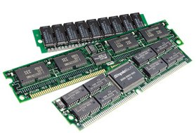
4.2) Internal Memory
There are 3 types of internal
memory:
a) Registers (in the CPU)
b) Cache
c) Main Memory (RAM & ROM)
Information stored in internal memory can be accessed with greater speed by the CPU compared to external memory.
Internal memory is contained on computer chips and uses electronic circuits to store information
Internal memories are volatile, only with exception to ROM

Slide 6
Main Memory
Central Storage of the computer.
Used to store instructions and data that are being executed (run)
They are built based on Semiconductor Integrated Circuits
Basically, they are divided into RAM and ROM

Slide 7
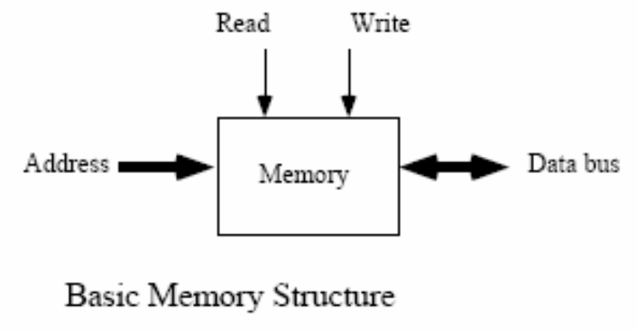
Unique address for each location
n address bits can address 2^{n} locations
Access one word at a time
Basic operations are read and write

Slide 8


RAM
Acronym for Random Access Memory
Information in RAM can be read and modified (write)
Used to store programs and user data that is being executed (run)
When an instruction set (or program) is typed into a computer, the program is stored in a part of this main memory called the RAM.
When the computer is switched off, the program will disappear from the RAM.
A kind of volatile memory, i.e. the content in RAM will be wiped out if electricity supply is interrupted.
Notes:
SSK3207

Slide 9
Types of RAM
Static RAM (SRAM)
  Made from flip-flop – a logic circuit which retains the information stored in it as long as there is enough power to run the device
  Disadvantages : expensive, small storage capacity in a chip
  Advantages : easier to use and faster access time (read and write cycle)
Dynamic RAM (DRAM)
  Made from capacitors
  Disadvantages : slower access time, harder to use because capacitors need to be charge (‘refresh’) for a certain amount of time
  Advantages: cheaper, bigger storage capacity in a chip
  A few improvements has been done on DRAM to improve its performance (access time) with different method and names, e.g., EDRAM, CDRAM, SDRAM, RDRAM etc

Slide 10
Following is a block diagram for a unit (chip) RAM that has 2^{k} word and the length of each word is n bit
n input line (from data bus)
k address line (from bus address)
RAM
(2^{k} x n)
2^{k} word
From control bus
read
write
n bit
n output line (to data bus)
Note:
memory is measured in base 2 units
capacity in internal memory is typically expressed in terms of bytes or words

Slide 11
For example, a 2²⁴ x 16 RAM memory contains 2²⁴ = 16M words, each 16 bits long.
? input line (from data bus)
? address line (from bus address)
RAM
(2²⁴ x 16)
2²⁴ word
From control bus
read
write
? bit
Total capacity =
2²⁴ x 16 = 2²⁴ x 2⁴ = 2²⁸ bits
= 2²⁵ bytes
? output line (to data bus)

Slide 12
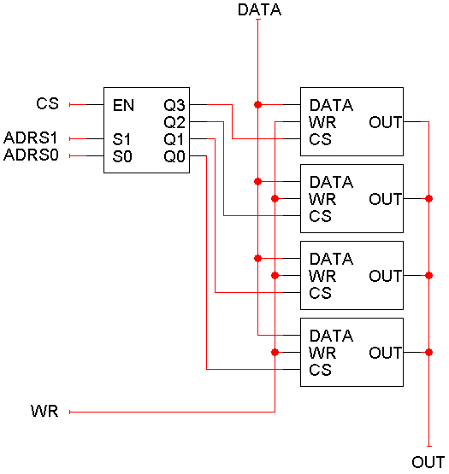
Example -- RAM
We can use these cells to make a 4 x 1 RAM.
Since there are four words, ADRS is two lines.
Each word is only one bit, so DATA and OUT are one bit each.
Notes: CS (chip select), enables or disables the RAM, WR selects between reading from or writing

Slide 13
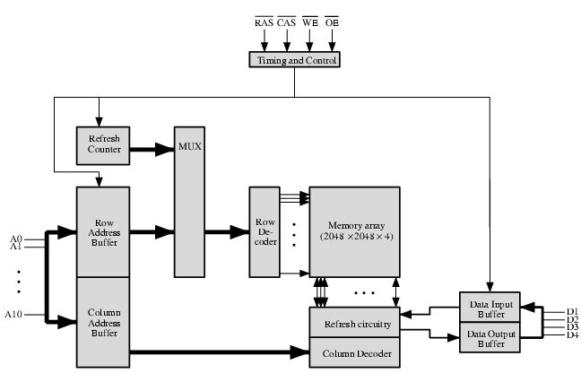
Chip Organization
Example of a DRAM organization

Slide 14
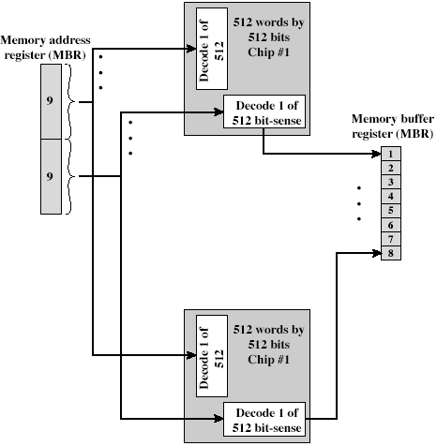
Module Organization
Example:
  Memory module of 256K words of 8 bit each

Slide 15
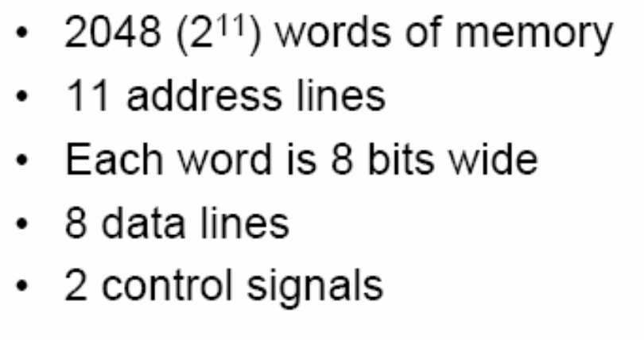
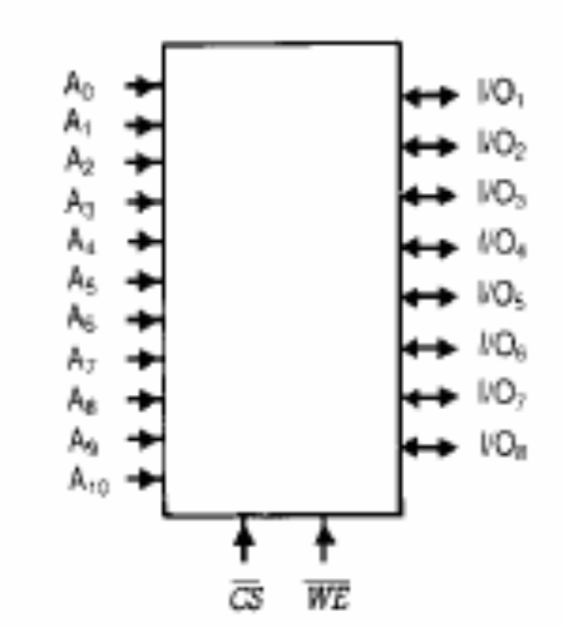
8 bits
11 address lines
8 data lines
2 control signals

Slide 16
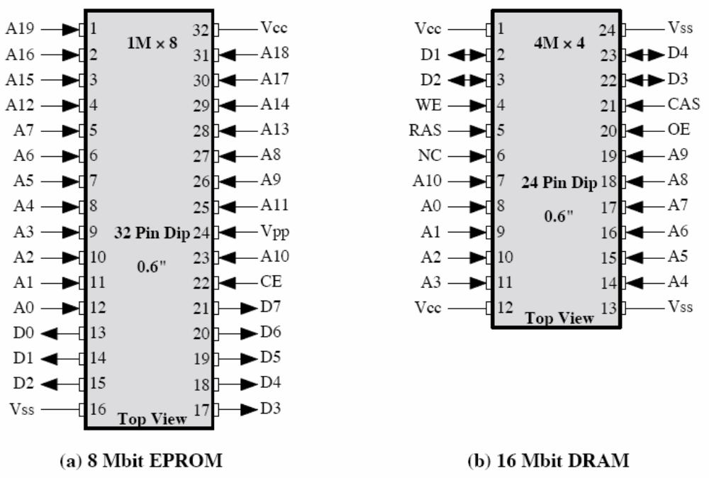
4 bits, 4 data lines in and out
2²² words, each 4 bits wide
22 address lines are required → note that there are only 11??? → the chip is designed to save number of pins, the address is multiplexed on the eleven pins (2¹¹ x 2¹¹)

Slide 17
ROM
Acronym for Read Only Memory
Information in ROM can only be read (cannot be written or modified)-- programmed on the ROM chips by the manufacturer
Used to store permanent programs, e.g.:
  bootstrap loader, i.e. a program used to start the operation of a computer when the computer is turned on
  Check to see that the cable to the printer is connected
  Interpret each key on the Keyboard to the control unit
There are various kinds of ROM, among them are PROM, EPROM and EEPROM. The difference is the ability to change data in them using specific methods and equipments

Slide 18
The following is a block diagram of a ROM with the size of 2^{k} x n (2^{k} word and the length of each word is n bit)
k address line (from address bus)
n data line (from data bus)
2^{k} word
n bit
Note:
Why don’t ROM chips have read-write pins?

Slide 19
8 bits, 8 data lines to be read out
2²⁰ words, each 8 bits wide

Slide 20
4.3) External Memory
Memories that are separated from the main computer components
Also known as secondary memory
Instances of external memory are hard disks, diskettes, CD-ROM, USB (universal serial bus) drive etc

Slide 21
External Memory (Cont.)
All external memory are non-volatile -- data stored in internal memory is lost (except ROM) when the computer is turned off but data stored in external memory is retained.
Used to store information (program and data) that has not or has already been processed by the computer system.
Consists of secondary storage devices such as discs and tapes where information contained in them are accessed by the CPU through the I/O unit (via bus)..

Slide 22
Disk
The 2 most popular types:
  Magnetic Disk
  Flash Memory
Magnetic Disk
There are 2 kinds, i.e. hard disk and floppy disk.
A round platter made from metal or plastic and shrouded with magnetic coating

Slide 23
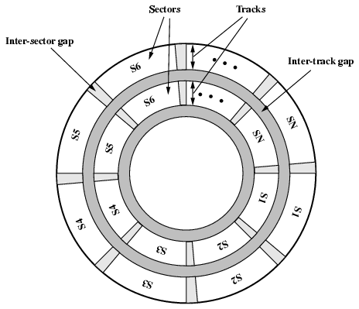
Disk Data Layout
Notes:
SSK3207

Slide 24
Disk Data Layout (cont.)
Consists of tracks and sectors
  - Track: 500 – 2000 tracks/surface
  - Sector: 10 – 100 sector/track (fixed or varied)
Data are moved into/taken out from the disk in block size (sector/track)
The amount of data in every track is same => data density varies
There are 2 types of read/write heads:
  1. Fixed head: One head per track
  2. Movable head: One head for all tracks
Disks are inserted into the disk drive.
There are 2 types of disk:
  Movable disk: can be inserted and taken out from the disk drive, such as the floppy disk.
  Fixed disk: cannot be taken out from the disk drive, for instance hard disk.

Slide 25
Flash Memory
2 types of flash memory : static and removable
A type of nonvolatile memory that can be erased electronically and rewritten, similar to EEPROM.
Most computers use flash memory to hold their startup instructions because it allows the computer easily to update its contents.
Flash memory chips also store data and programs on many mobile computers and devices such as smart phones, portable media players, PDAs, printers, digital cameras, automotive devices, pagers and digital voice recorders.

Slide 26
Flash Memory (Cont)
Removable flash memory includes memory cards, USB flash drive, and PC Cards/ExpressCard Module

Slide 27
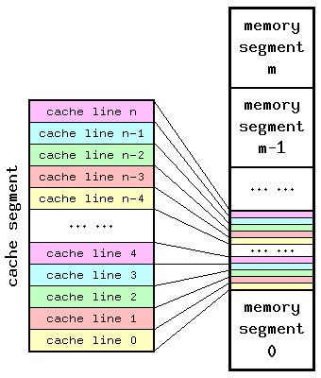
4.4) Cache Memory System

Slide 28
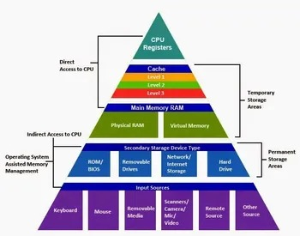
Hierarchy List
L1 Cache
L2 Cache
Main memory
Disk cache
Disk
Optical
TapeRegisters
Memory Hierarchy - Diagram
Notes:
SSK3207

Slide 29
So you want fast?
It is possible to build a computer which uses only static RAM (see later)
This would be very fast
This would need no cache
  How can you cache cache?
This would cost a very large amount
Notes:
SSK3207

Slide 30
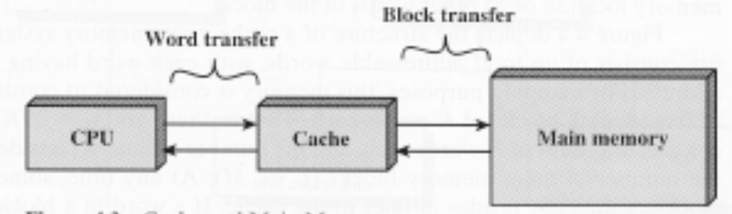
Why do we need cache?
Memory is slow compared to the time required to execute instructions
Memory becomes more expensive as it gets faster
Compromise
  Place a small amount of very high speed memory to temporarily hold a portion of the memory being accessed.

Slide 31
Cache
Small amount of fast memory
Sits between normal main memory and CPU
May be located on CPU chip or module
Notes:
SSK3207

Slide 32
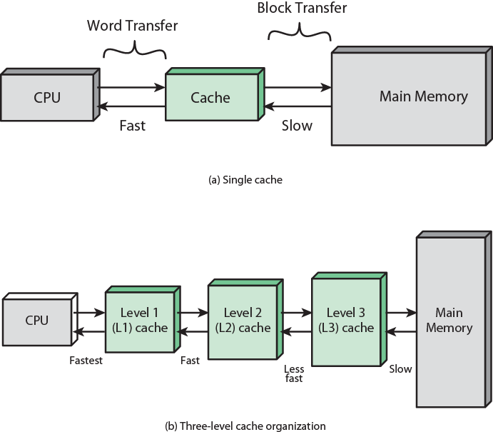
Cache and Main Memory

Slide 33
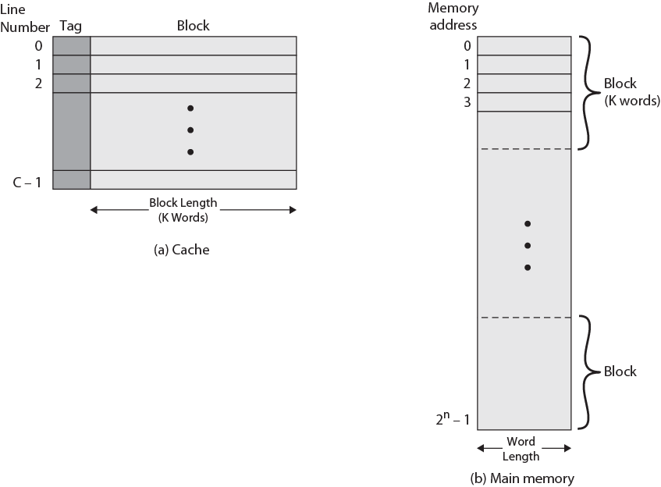
Cache/Main Memory Structure

Slide 34
CPU
CACHE: divided into a few slots
MM: divided into a few blocks or lines
(block size = slot size)
Example:
MM = 16 Mbytes
Memory block = 4 bytes
Memory = 4M blocks of 4 bytes each
Cache can hold 64 Kbytes
Cache is 16K lines of 4 bytes each

Slide 35
Figure shows connection of Cache and Main Memory
Word Transfer
Block Transfer
Main Memory
CPU
Cache

Slide 36
Cache Addressing
Where does cache sit?
  Between processor and virtual memory management unit
  Between MMU and main memory
Logical cache (virtual cache) stores data using virtual addresses
  Processor accesses cache directly, not thorough physical cache
  Cache access faster, before MMU address translation
  Virtual addresses use same address space for different applications
    Must flush cache on each context switch
Physical cache stores data using main memory physical addresses

Slide 37
Cache Memory (cont.)
A small and fast memory that situated between the CPU and the MM (conceptually, not physically).
Reduces the difference of time of the memory cycle and the CPU processing time.
The memory cycle time is the time used to fetch an instruction or data from the main memory until it is usable.
With the technology available today, the processing time of the CPU is faster than the memory cycle time by far.
Hence, a memory, which was called Cache, was introduced and it was situated between the CPU and the MM.

Slide 38
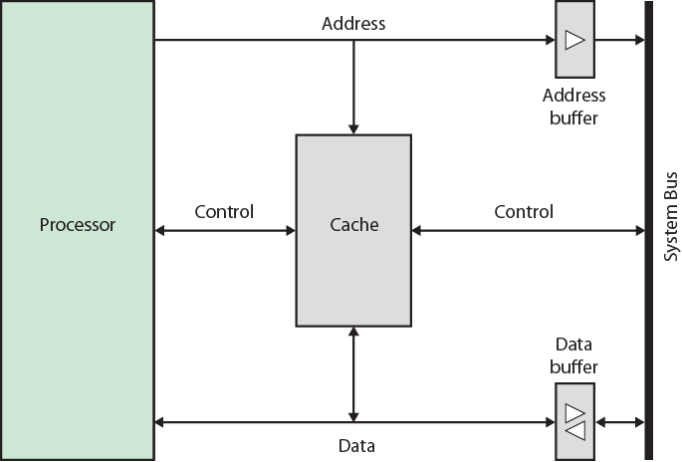
Typical Cache Organization
data and address lines attached to buffers → attached to system bus to reach main memory
Cache connects to the processor via data, control, and address lines
Notes:
SSK3207

Slide 39
The method used for cache manufacturing rendered its memory cycle time far faster than that of the main memory but its cost was very expensive.
We would like the size of the cache to be small enough so that the overall average cost per bit is close to that of main memory alone and large enough so that the overall average access time is close to that of the cache alone.
What is the ideal size for the cache??????
How does cache work?

Slide 40
How Cache Works?
When the CPU needs certain data or instruction, it will refer to the cache memory first.
If it is in cache, then data access will be fast.
Otherwise, it will have to be fetched from the MM and the data block that contains the required data or instruction will be moved into the Cache Memory with the hope that the next instruction/data required by the CPU is contained in the block.

Slide 41
Cache operation – overview
CPU requests contents of memory location
Check cache for this data
If present, get from cache (fast)
If not present, read required block from main memory to cache
Then deliver from cache to CPU
Cache includes tags to identify which block of main memory is in each cache slot
Notes:
SSK3207

Slide 42
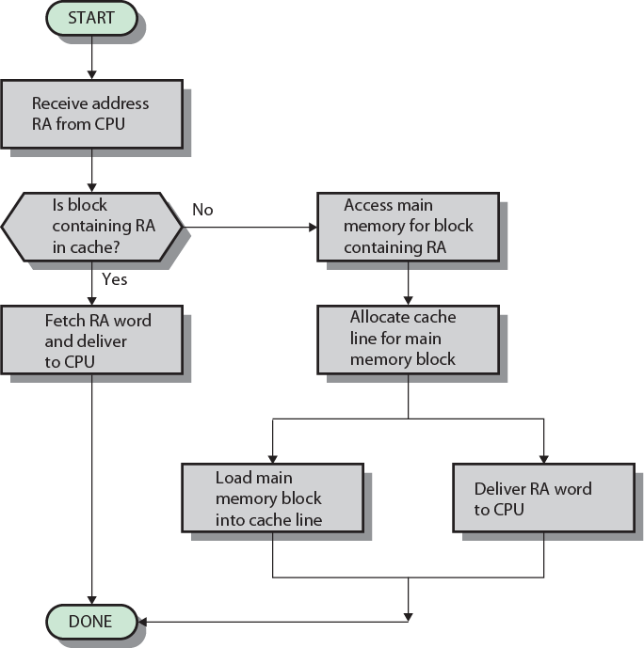
Cache Read Operation - Flowchart

Slide 43
Because there are fewer cache lines than main memory blocks, an algorithm is needed for mapping main memory blocks into cache lines/slots. Three techniques can be used: direct, associative and set-associative.
Once the cache has been filled, when a new block is brought into the cache, one of the existing blocks must be replaced. A replacement algorithm is needed. What types of algorithm???????

Slide 44
Cache Replacement Algorithm
LRU – least recently used
FIFO – first in first out
LFU – least frequently used

Slide 45
Cache Design
Addressing
Size
Mapping Function
Replacement Algorithm
Write Policy
Block Size
Number of Caches
Notes:
SSK3207

Slide 46
Size does matter
Cost
  More cache is expensive
Speed
  More cache is faster (up to a point)
  Checking cache for data takes time
Notes:
SSK3207

Slide 47
Comparison of Cache Sizes
Processor
Type
Year of Introduction
L1 cache
L2 cache
L3 cache
IBM 360/85
Mainframe
1968
16 to 32 KB
—
—
PDP-11/70
Minicomputer
1975
1 KB
—
—
VAX 11/780
Minicomputer
1978
16 KB
—
—
IBM 3033
Mainframe
1978
64 KB
—
—
IBM 3090
Mainframe
1985
128 to 256 KB
—
—
Intel 80486
PC
1989
8 KB
—
—
Pentium
PC
1993
8 KB/8 KB
256 to 512 KB
—
PowerPC 601
PC
1993
32 KB
—
—
PowerPC 620
PC
1996
32 KB/32 KB
—
—
PowerPC G4
PC/server
1999
32 KB/32 KB
256 KB to 1 MB
2 MB
IBM S/390 G4
Mainframe
1997
32 KB
256 KB
2 MB
IBM S/390 G6
Mainframe
1999
256 KB
8 MB
—
Pentium 4
PC/server
2000
8 KB/8 KB
256 KB
—
IBM SP
High-end server/ supercomputer
2000
64 KB/32 KB
8 MB
—
CRAY MTAb
Supercomputer
2000
8 KB
2 MB
—
Itanium
PC/server
2001
16 KB/16 KB
96 KB
4 MB
SGI Origin 2001
High-end server
2001
32 KB/32 KB
4 MB
—
Itanium 2
PC/server
2002
32 KB
256 KB
6 MB
IBM POWER5
High-end server
2003
64 KB
1.9 MB
36 MB
CRAY XD-1
Supercomputer
2004
64 KB/64 KB
1MB
—

Slide 48
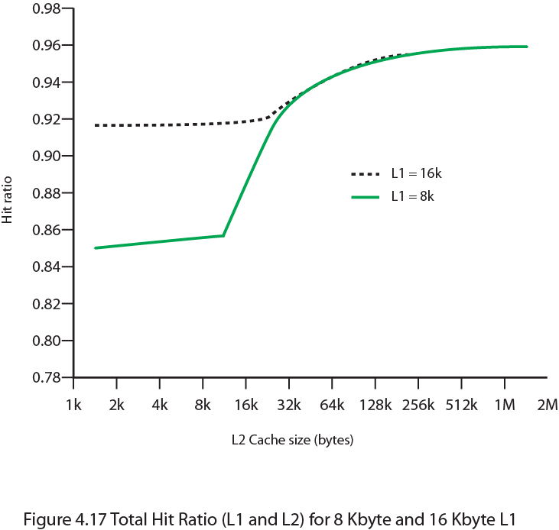
Hit Ratio (L1 & L2)
For 8 kbytes and 16 kbyte L1

Slide 49
Unified v Split Caches
One cache for data and instructions or; two, one for data and one for instructions
Advantages of unified cache
  Higher hit rate
    Balances load of instruction and data fetch
    Only one cache to design & implement
Advantages of split cache
  Eliminates cache contention between instruction fetch/decode unit and execution unit
    Important in pipelining

Slide 50
Pentium 4 Cache
80386 – no on chip cache
80486 – 8k using 16 byte lines and four way set associative organization
Pentium (all versions) – two on chip L1 caches
  Data & instructions
Pentium III – L3 cache added off chip
Pentium 4
  L1 caches (8k bytes, 64 byte lines, four way set associative)
  L2 cache (Feeding both L1 caches, 256k, 128 byte lines, 8 way set associative)
  L3 cache on chip
Notes:
SSK3207

Slide 51
Intel Cache Evolution
Problem
Solution
Processor on which feature first appears
External memory slower than the system bus.
Add external cache using faster memory technology.
386
Increased processor speed results in external bus becoming a bottleneck for cache access.
Move external cache on-chip, operating at the same speed as the processor.
486
Internal cache is rather small, due to limited space on chip
Add external L2 cache using faster technology than main memory
486
Contention occurs when both the Instruction Prefetcher and the Execution Unit simultaneously require access to the cache. In that case, the Prefetcher is stalled while the Execution Unit’s data access takes place.
Create separate data and instruction caches.
Pentium
Increased processor speed results in external bus becoming a bottleneck for L2 cache access.
Create separate back-side bus that runs at higher speed than the main (front-side) external bus. The BSB is dedicated to the L2 cache.
Pentium Pro
Move L2 cache on to the processor chip.
Pentium II
Some applications deal with massive databases and must have rapid access to large amounts of data. The on-chip caches are too small.
Add external L3 cache.
Pentium III
Move L3 cache on-chip.
Pentium 4

Slide 52
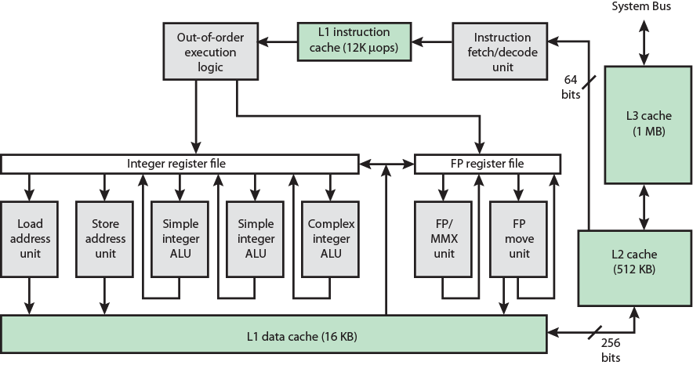
Pentium 4 Block Diagram

Slide 53
Pentium 4 Core Processor
Fetch/Decode Unit
  Fetches instructions from L2 cache
  Decode into micro-ops
  Store micro-ops in L1 cache
Out of order execution logic
  Schedules micro-ops
  Based on data dependence and resources
  May speculatively execute
Execution units
  Execute micro-ops
  Data from L1 cache
  Results in registers
Memory subsystem (L2 cache and systems bus)

